Slide 1
Circuit and Packet Switching Networks
Circuit Switching Vs. Packet switching
Traffic and Overload Control in Telephone Networks

Slide 2
Packet Switching vs. Circuit Switching
Packet-switched and circuit-switched networks use two different technologies for sending messages and data from one point to another.
Each has its advantages and disadvantages depending on what you are trying to do.
adapted from www.teach-ict.com

Slide 3
Packet Switching
In packet-based networks, the message gets broken into small data packets.
These packets are sent out from the computer and they travel around the network seeking out the most efficient route to travel as circuits become available.
This does not necessarily mean that they seek out the shortest route.
Each packet may go a different route from the others.

Slide 4
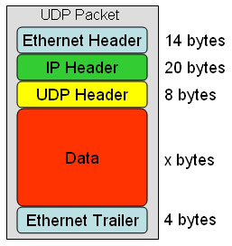
Packet Switching
Each packet is sent with a ‘header address’ which tells it where its final destination is, so it knows where to go.
The header address also describes the sequence for reassembly at the destination computer so that the packets are put back into the correct order.
One packet also contains details of how many packets should be arriving so that the recipient computer knows if one packet has failed to turn up.
If a packet fails to arrive, the recipient computer sends a message back to the computer which originally sent the data, asking for the missing packet to be resent.
UDP =
User Datagram Protocol

Slide 5
Packet Switching
Advantages
Security
Bandwidth used to full potential
Devices of different speeds can communicate
Not affected by line failure (redirects signal)
Availability – no waiting for a direct connection to become available
During a crisis or disaster, when the public telephone network might stop working, e-mails and texts can still be sent via packet switching

Slide 6
Packet Switching
Disadvantages
Under heavy use there can be a delay
Data packets can get lost or become corrupted
Protocols are needed for a reliable transfer
Not so good for some types data streams (e.g. real-time video streams can lose frames due to the way packets arrive out of sequence)

Slide 7
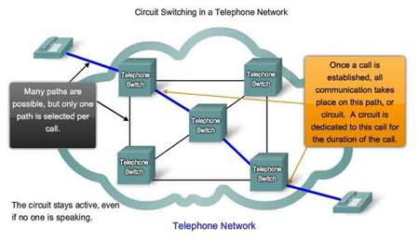
Circuit Switching
Circuit switching was designed in 1878 in order to send telephone calls down a dedicated channel.
This channel remains open and in use throughout the whole call and cannot be used by any other data or phone calls.

Slide 8
Circuit Switching
There are three phases in circuit switching:
Establish
Transfer
Disconnect
The telephone message is sent all together; it is not broken up.
The message arrives in the same order that it was originally sent.

Slide 9
Circuit Switching
In modern circuit-switched networks, electronic signals pass through several switches before a connection is established.
During a call no other network traffic can use those switches.
The resources remain dedicated to the circuit during the entire data transfer and the entire message follows the same path.
Circuit switching can be analog or digital.

Slide 10
Circuit Switching
With the expanded use of the Internet for voice and video, analysts predict a gradual shift away from circuit-switched networks.
A circuit-switched network is excellent for data that needs a constant link from end-to-end, for example, real-time video.

Slide 11
Circuit Switching
Advantages
Circuit is dedicated to the call – no interference, no sharing
Guaranteed the full bandwidth for the duration of the call
Guaranteed quality of service

Slide 12
Circuit Switching
Disadvantages
Inefficient – the equipment may be unused for a lot of the call; if no data is being sent, the dedicated line still remains open.
It takes a relatively long time to set up the circuit.
During a crisis or disaster, the network may become unstable or unavailable.
It was primarily developed for voice traffic rather than data traffic.

Slide 13
Traffic Management & Overload Control
Telephone calls come and go
People activity follow patterns
Mid-morning & mid-afternoon at office
Evening at home
Summer vacation
Outlier Days are extra busy
Mother’s Day, Christmas, …
Disasters & other events cause surges in traffic
Need traffic management & overload control

Slide 14
Traffic concentration
Many
lines
Fewer
trunks
Traffic fluctuates as calls initiated & terminated
Driven by human activity
Providing resources so
Call requests always met is too expensive
Call requests met most of the time cost-effective
Switches concentrate traffic onto shared trunks
Blocking of requests will occur from time to time
Traffic engineering provisions resources to meet blocking performance targets

Slide 15
Fluctuation in Trunk Occupancy
Number of busy trunks
N(t)
All trunks busy, new call requests blocked
t
1
active
2
active
3
active
Trunk number
active
active
4
5
active
6
active
active
7
active
active

Slide 16
Modeling Traffic Processes
Find the statistics of N(t) the number of calls in the system
Model
Call request arrival rate: λ requests per second
The resulting random process is a Poisson arrival process:
(λT)^{k}e^{–λT} k!
Prob(k arrivals in time T) =
Holding time: Time a user maintains a connection
X a random variable with mean E(X), when X is exponential, the service rate 𝝁 =1/E[X]
Offered load: rate at which work is offered by users:
𝞺 = λ (calls/second) * E(X) (seconds/call)
𝞺 = λ /𝝁

Slide 17
Blocking Probability & Utilization
c = Number of Trunks or channels
Blocking occurs if all channels are busy, i.e. N(t)=c
If call requests are Poisson, then blocking probability P_{b} is given by Erlang B Formula
𝝆^{c}
c!
P_{b} =
c
∑ 𝝆^{k}
j!
j=0
The utilization is the average # of channels in use
Utilization = λ(1 – P_{b}) E[X]/c = (1 – P_{b}) 𝝆/c

Slide 18
Blocking Probability & Utilization
Erlang B Formula can be written recursively as follows:
𝝆 P_{b}(c-1,𝝆)
C +𝝆 P_{b}(c-1,𝝆)
P_{b}(c,𝝆) =

Slide 19
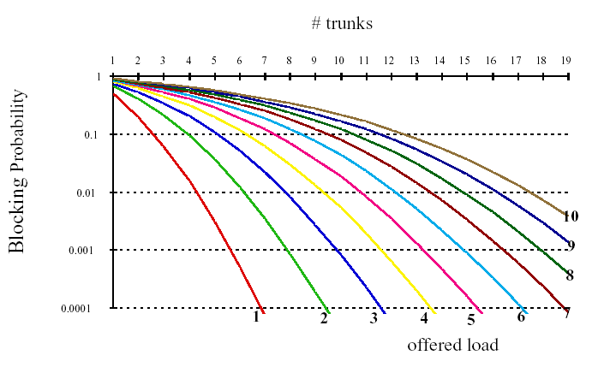
Blocking Performance
a
To achieve 1% blocking probability:
𝝆 = 5 Erlangs requires 11 trunks
𝝆 = 10 Erlangs requires 18 trunks

Slide 20
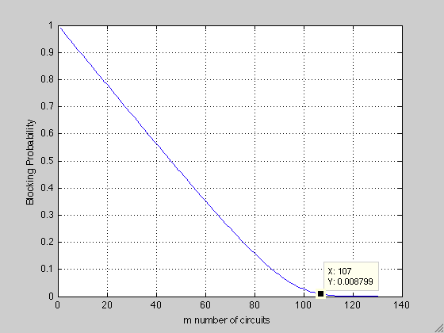
MATLAB Example

